Slide 1
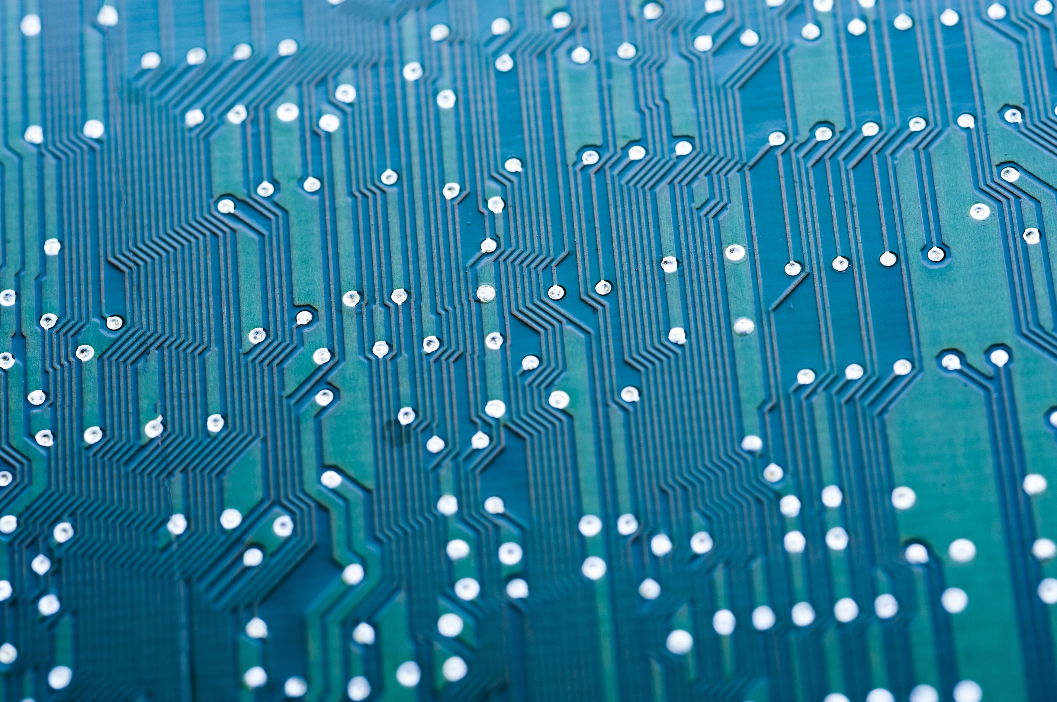
DEPARTMENT OF COMPUTER SCIENCE
PRESENTS
IT FEST
A FREE EVENT FOR ALL STUDENTS
EXPERIENCE THE LATEST TRENDS IN TECHNOGLOGY AND CAREER PATHWAYS IN IT SECTOR
This Photo by Unknown Author is licensed under CC BY

